Slide 1

Infrared Sensor-Based Automatic Pet Door
MAE 6291
Midterm Project
By Puchen Wang
Notes:
亮亮图文旗舰店https://liangliangtuwen.tmall.com

Slide 2
Motivation
1
2
3
Passive pet doors
Commercial RFID pet doors
Camera and computer vision
allowing intrusion by small pests
wearable tags are easy to loss
High-costly and complex

Slide 3
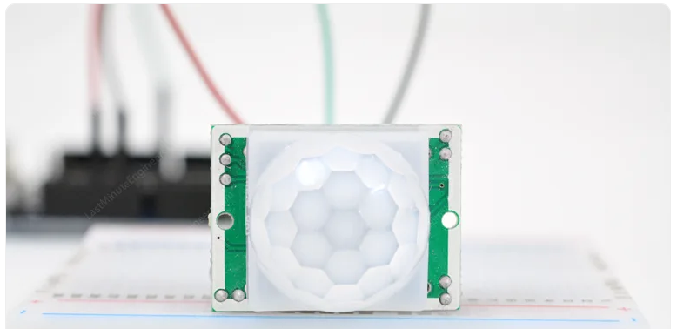

Sensors and Hardware
Resource: How HC-SR501 PIR Sensor Works & Interface It With Arduino
https://lastminuteengineers.com/pir-sensor-arduino-tutorial/

Slide 4
Three-Layers
Perception
Network
Application
The PIR sensor detects pet movement and collects environmental data.
The Raspberry Pi processes sensor data, controls hardware, and communicates with external systems (like email servers).
The application layer provides end-user services, sending automated email notifications to pet owners to keep them informed about their pets’ activities remotely.

Slide 5
Moving Forward
Further More…
Reduce False Alarms
Upgrade Features
Data Analysis
User Interface Improvement

